Slide 1
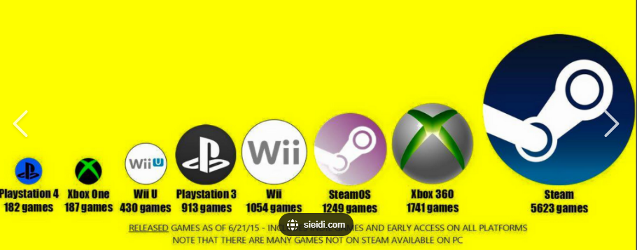
EDA
GROUP 5
VIDEO GAME SALES

Slide 2
Intended for:
Entrepreneurs that are interested in setting up a game shop
Companies that want to develop video games
Companies that want to develop a gaming platform

Slide 3

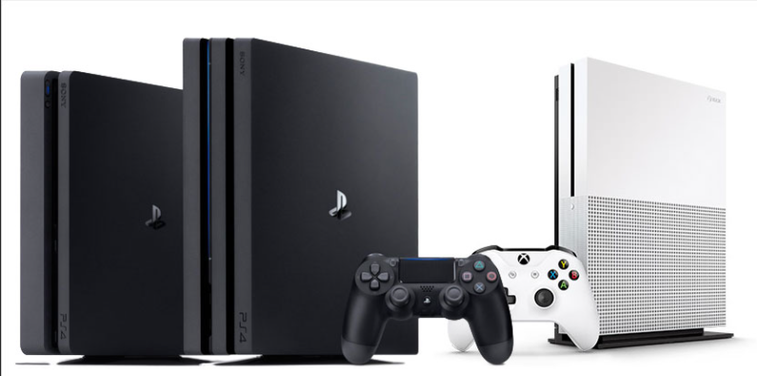
Definition of Terms
Genre : Talks about the types
Platform : Which device the game is played on

Slide 4
DATA DESCRIPTION
Has 16,599 tuples
Has 11 Fields or attributes which includes:

Slide 5
DATA DESCRIPTION - FIELDS
Rank - Ranking of overall sales
Name - The games name
Platform - Platform of the games release (i.e. PC,PS4, etc.)
Year - Year of the game's release
Genre - Genre of the game
Publisher - Publisher of the game

Slide 6
DATA DESCRIPTION - FIELDS
NA_Sales - Sales in North America (in millions)
EU_Sales - Sales in Europe (in millions)
JP_Sales - Sales in Japan (in millions)
Other_Sales - Sales in the rest of the world (in millions)
Global_Sales - Total worldwide sales.

Slide 7
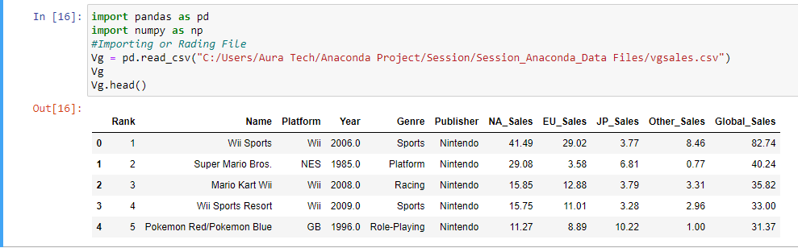

Slide 8
What to analyze
Does Global Sales depend on Popularity of Platform, Genre or Publisher
Year has a range from 1980 – 2020
From 20th Century (1980 – 1990) & 21st Century (2015 – 2020)

Slide 9
Popularity
Game Platforms (2600, DS, PS,PS2 and etc.)
Game Genre (Action, Adventure,......)
Game Publisher (Activision, Atari,....)

Slide 10
Average Global Sales
Based on Plaforms
Based on Genre
Based on Publisher

Slide 11
Assumption
If 2 possibilities of popularity correlating with high global sales, then increase in sales is dependent on high popular rates.

Slide 12
PLATFORM AND LIBRARIES
Python (Jupyter Notebook)
Pandas
Numpy
Matplotlib
Seaborn

